Slide 1

Foundation PHYSICS
Seminar 2: Dynamics and Work/Energy

Slide 2
Learning outcomes
Students are expected to understand the concepts and resolve the following mechanical problems regarding:
Newton’s Laws
Work
Conservation of Energy

Slide 3
Practice Questions
Give an example of a situation in which there is a force and a displacement, but the force does no work. Explain why it does no work.
How are inertia and mass related?

Slide 4
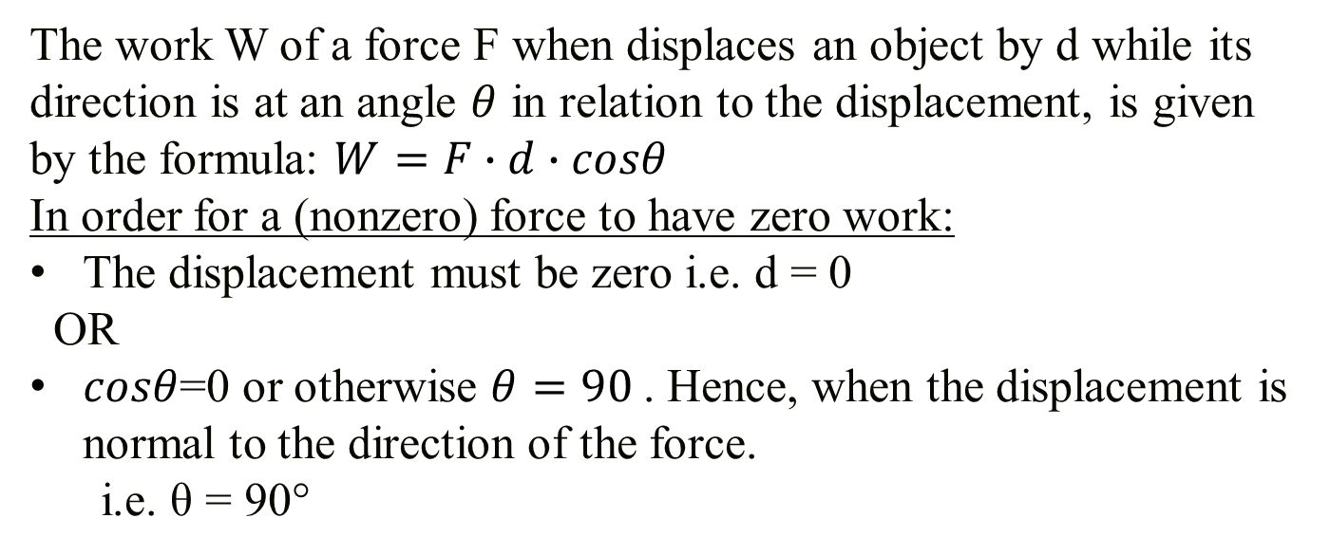
ANSWER: Practice Question 1
The work W of a force F when displaces an object by d while its direction is at an angle $θ$ in relation to the displacement, is given by the formula: $W=F∙d∙cosθ$
In order for a (nonzero) force to have zero work:
The displacement must be zero i.e. d = 0
OR
$cosθ$=0 or otherwise $θ=90$. Hence, when the displacement is normal to the direction of the force.
i.e. θ = 90°
Example: A heavy box is moved horizontally
Imagine you are carrying a heavy box across a room. The force you exert the box is upward, balancing the gravitational force pulling the box down. As you walk horizontally, the box is displaced in the horizontal direction. Technically this force produces no work as it is perpendicular to the displacement.

Slide 5
ANSWER: Practice Question 2
Inertia:
Inertia is the property of an object that resists changes in its state of motion.
In simple terms, an object with inertia will stay at rest if it is at rest, or continue moving at a constant velocity if it is already in motion, unless acted upon by an external force.
Mass:
Mass is a measure of the amount of matter in an object.
It is also a measure of an object's inertia. The more mass an object has, the greater its inertia, meaning it is more resistant to changes in its motion.

Slide 6
ANSWER: Practice Question 2
Relationship:
The relationship between inertia and mass is direct and proportional. Objects with larger mass have greater inertia. This means that a heavier object (with more mass) will be harder to start moving if it's at rest, harder to stop if it's moving, and harder to change its direction or speed compared to a lighter object with less mass.
In summary, mass is a quantitative measure of inertia: the greater the mass of an object, the greater its inertia.

Slide 7
Question 1
Suppose two children push horizontally, but in exactly opposite directions, on a third child in a wagon. The first child exerts a force of 75.0 N, the second a force of 90.0 N. Please take into account that friction is 12.0 N, and the mass of the third child plus wagon is 23.0 kg.
What is the system of interest if the acceleration of the child in the wagon is to be calculated?
Draw a free-body diagram, including all forces acting on the system.
Calculate the acceleration.
What would the acceleration be if friction were 15.0 N?

Slide 8
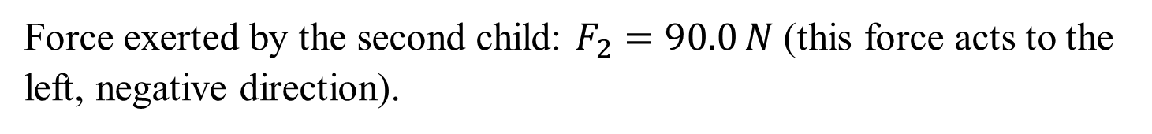
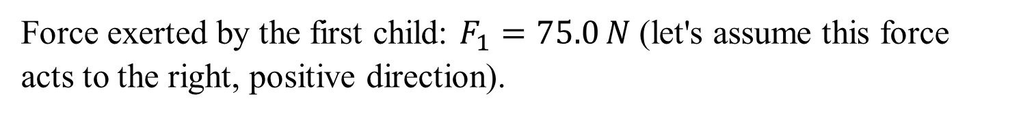
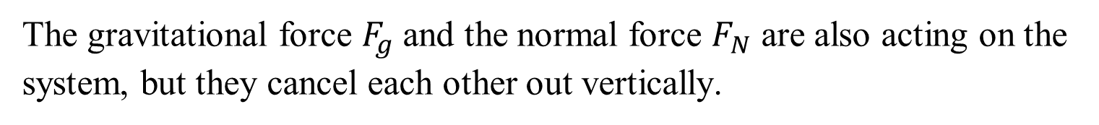
Question 1: ANSWERS
(a) The system of interest
System of Interest: The system of interest is the third child plus the wagon. We are considering the net force acting on this system to calculate the acceleration.
Forces Acting on the System:
Force exerted by the first child: $F_{1}=75.0 N$ (let's assume this force acts to the right, positive direction).
Force exerted by the second child: $F_{2}=90.0 N$ (this force acts to the left, negative direction).
Frictional force: $F_{friction}=12.0 N$ (opposes the direction of motion).
The gravitational force $F_{g}$ and the normal force $F_{N}$ are also acting on the system, but they cancel each other out vertically.

Slide 9
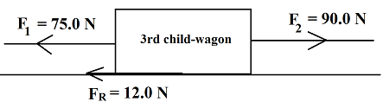

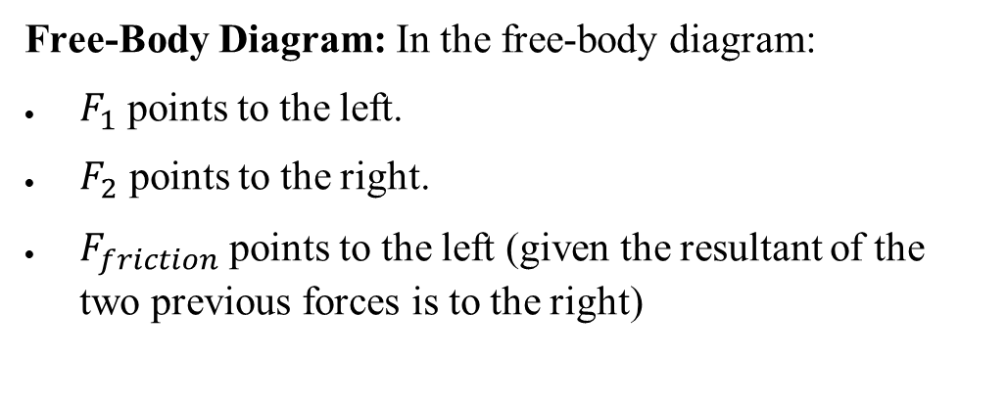


Question 1: ANSWERS
(b) Draw a free-body diagram
Free-Body Diagram: In the free-body diagram:
$F_{1}$ points to the left.
$F_{2}$​ points to the right.
$F_{friction}$ points to the left (given the resultant of the two previous forces is to the right)
(c) Calculate acceleration
The net force acting on the system is the sum of all the forces:
$$F_{net}=F_{2}−F_{1}−F_{friction}$$
Substituting the given values:
$$F_{net}=90N−75N−12N$$
$$F_{net}=3N$$
The net force is acting to the left.

Slide 10

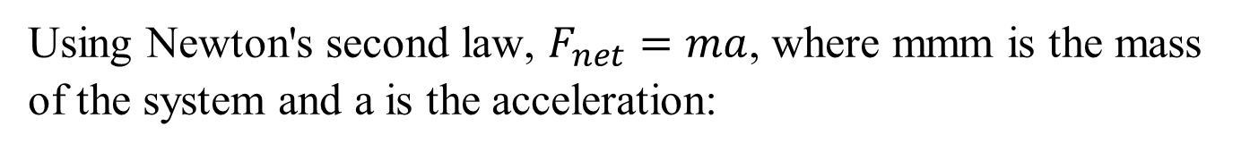
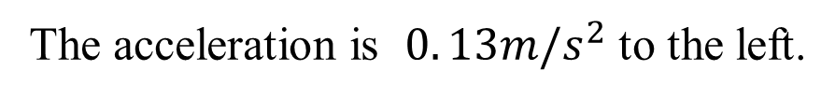
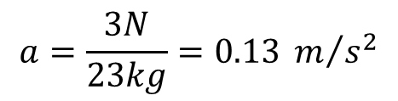
Question 1: ANSWERS
(c) Calculate acceleration
Using Newton's second law, $F_{net}=ma$, where mmm is the mass of the system and a is the acceleration:
$$a=\frac{F_{net}}{m}$$
Substituting the known values:
$$a=\frac{3N}{23kg}=0.13 m/{s^{2}}$$
The acceleration is $0. 13m/s^{2}$ to the left.

Slide 11

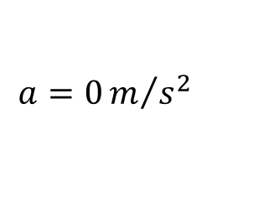

Question 1: ANSWERS
(d) Calculate acceleration be if friction were 15.0 N
If the frictional force is increased to 15.0 N:
$$F_{net}=90N−75N−15N$$
$$F_{net}=0N$$
Now, the acceleration is:
$$a=0m/{s^{2}}$$
The system is in equilibrium

Slide 12
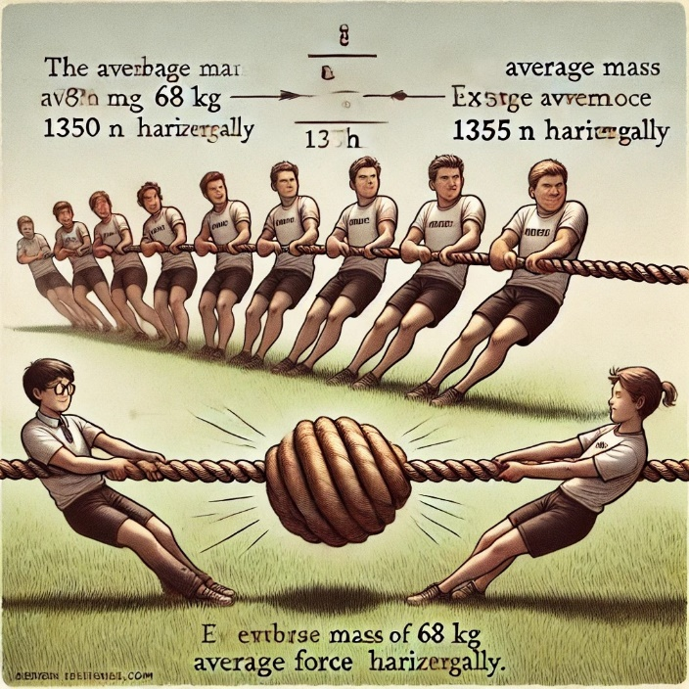
Question 2
Two teams of nine members each engage in a tug of war. Each of the first team’s members has an average mass of 68 kg and exerts an average force of 1350 N horizontally. Each of the second team’s members has an average mass of 73 kg and exerts an average force of 1365 N horizontally.
What is magnitude of the acceleration of the two teams?
What is the tension in the section of rope between the teams?

Slide 13
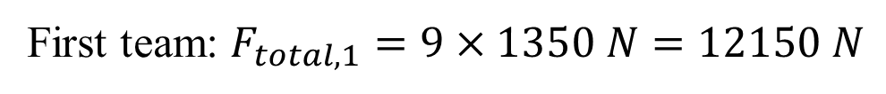
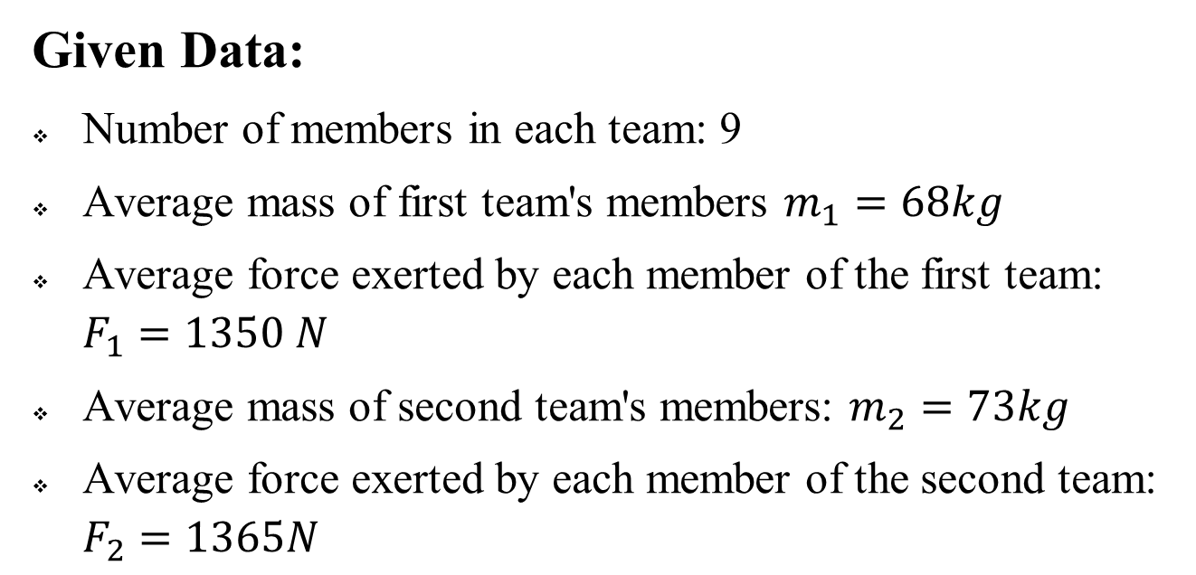
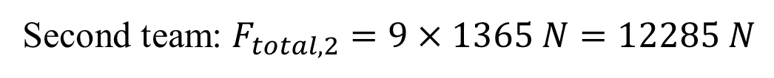
Question 2: ANSWERS
Given Data:
Number of members in each team: 9
Average mass of first team's members $m_{1}​=68kg$
Average force exerted by each member of the first team: $F_{1}​=1350 N$
Average mass of second team's members: $m_{2}​=73kg$
Average force exerted by each member of the second team: $F_{2}​=1365N$
(a) Magnitude of the Acceleration of the Two Teams
Total force exerted by each team:
First team: $F_{total,1}=9×1350 N=12150 N$
Second team: $​F_{total,2}=9×1365 N=12285 N$

Slide 14


Question 2: ANSWERS
(a) Magnitude of the Acceleration of the Two Teams
Net force acting on the system:
$$F_{net}=F_{total,2}−F_{total,1}$$
$$F_{net}=12285 N−12150 N=135 N$$
The net force is in the direction of the second team because they exert more force.
Total mass of the system:
Total mass of the first team: $​M_{1}=9×68kg=612 kg$
Total mass of the second team: $M_{2}=9×73kg=657 kg$
Total mass of both teams: $M_{total}​=M_{1}+M_{2}=612 kg+657 kg$
$$M_{total}=1269 kg$$

Slide 15
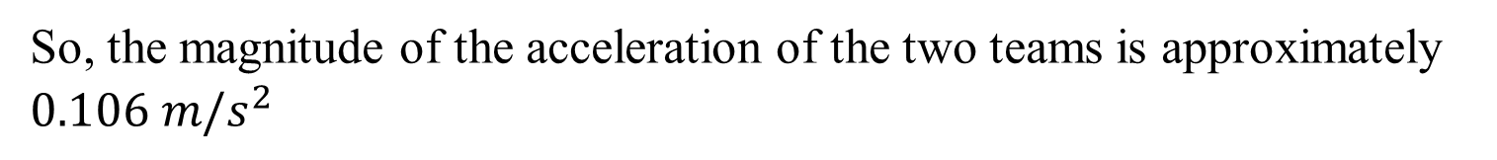
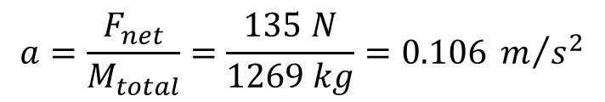
Question 2: ANSWERS
(a) Magnitude of the Acceleration of the Two Teams
According to Newton's second law:
$$a=\frac{F_{net}}{M_{total}}=\frac{135 N}{1269 kg}=0.106 m/{s^{2}}$$
So, the magnitude of the acceleration of the two teams is approximately $0.106 m/s^{2}$
(b) Tension in the Section of Rope Between the Teams
The tension in the rope can be found by considering the forces acting on either team separately. Let's consider the first team.
Total force exerted by the first team:
As calculated above $F_{total,1}=9×1350 N=12150 N$

Slide 16
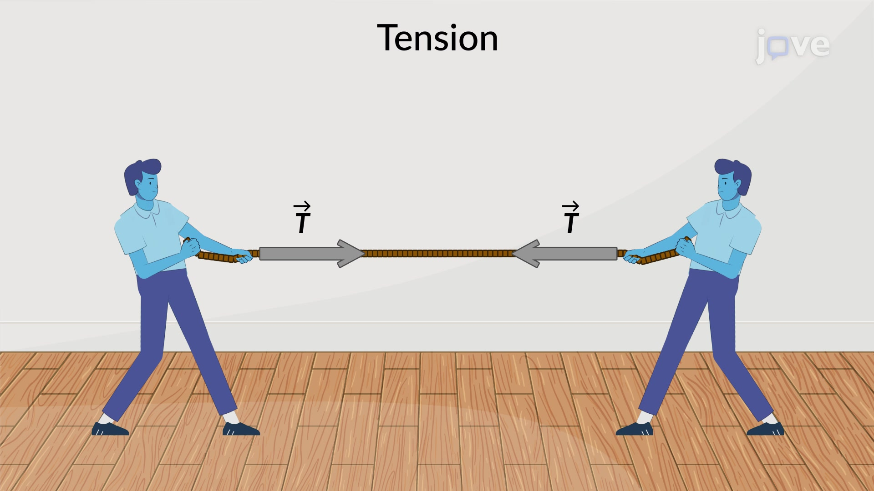


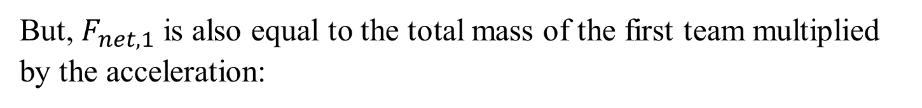
Question 2: ANSWERS
(b) Tension in the Section of Rope Between the Teams
Force of tension T in the rope (acting towards the second team):
The net force on the first team is the difference between the tension and the force they exert:
$$F_{net,1}=T−F_{total,1}$$
But, $F_{net,1}$​ is also equal to the total mass of the first team multiplied by the acceleration:
$$F_{net,1}=M_{1}×a=612 kg×0.106 m/s^{2}=64.872 N$$
$$64.872 N=T−12150 N$$
$$T=64.872 N+12150 N=12215$$
Therefore, the tension in the rope is approximately $12215 N$.

Slide 17
Question 3
A nurse pushes a cart by exerting a force on the handle at a downward angle 35.0º below the horizontal. The loaded cart has a mass of 28.0 kg, and the force of friction is 60.0 N.
Draw a free-body diagram for the system of interest.
(b) What force must the nurse exert to move at a constant velocity?

Slide 18
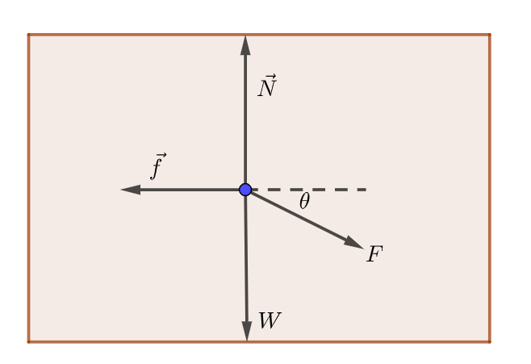
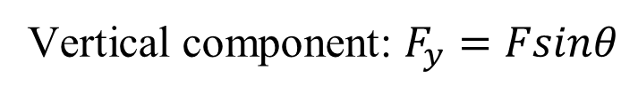
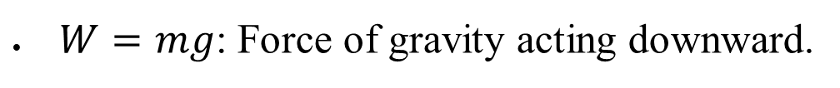
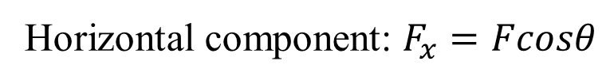
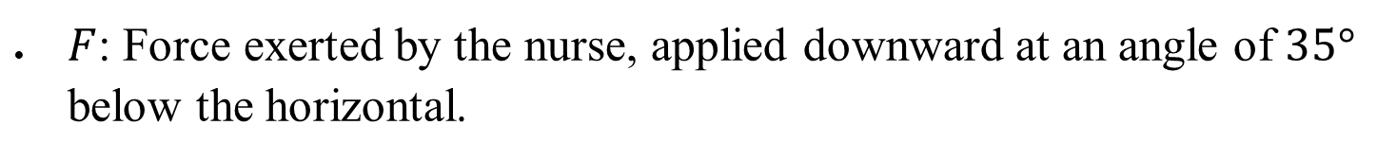
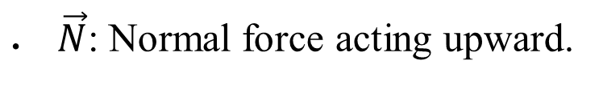
Question 3: ANSWERS
(a) Free-body diagram for the system of interest
The diagram shows the forces acting on the cart:
$W=mg$​: Force of gravity acting downward.
$\vec{N}$​: Normal force acting upward.
$\vec{f}$: Force of friction acting to the left, opposing the motion.
$F$: Force exerted by the nurse, applied downward at an angle of $35°$ below the horizontal.
Horizontal component: $F_{x}=Fcosθ$
Vertical component: $F_{y}=Fsinθ$

Slide 19

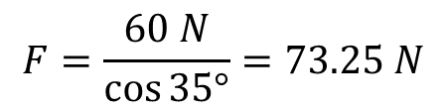




Question 3: ANSWERS
(b) Force Required to Move at Constant Velocity
To move the cart at a constant velocity, the net force in the horizontal direction must be zero.
$$F_{x}−f_{friction}=ma$$
$$F_{x}−f_{friction}=0$$
$$F_{x}=f_{friction}$$
$$F∙cosθ=f_{friction}$$
$$F=\frac{f_{friction}}{cosθ}$$
Substitute the given values:
$$F=\frac{60 N}{\cos{35°}}=73.25 N$$
Thus, the nurse must exert a force of approximately 73.25 N to move the cart at a constant velocity.

Slide 20
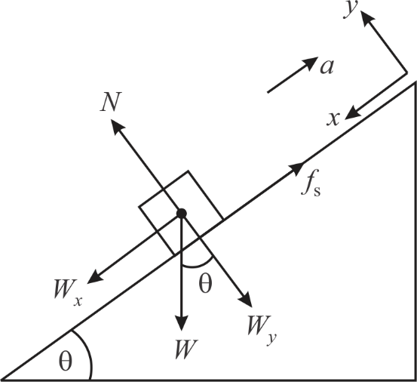
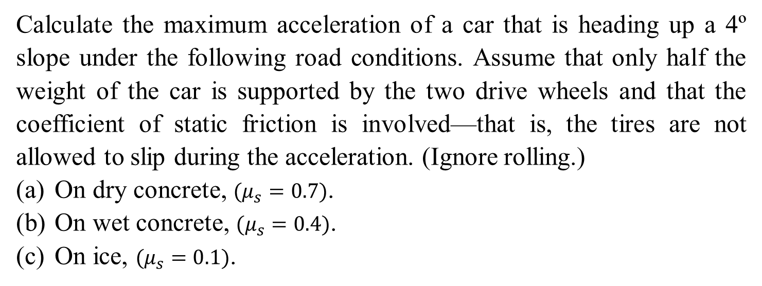
Question 4
Calculate the maximum acceleration of a car that is heading up a 4º slope under the following road conditions. Assume that only half the weight of the car is supported by the two drive wheels and that the coefficient of static friction is involved—that is, the tires are not allowed to slip during the acceleration. (Ignore rolling.)
On dry concrete, $(μ_{s}=0.7)$.
On wet concrete, $(μ_{s}=0.4)$.
On ice, $(μ_{s}=0.1)$.

Slide 21
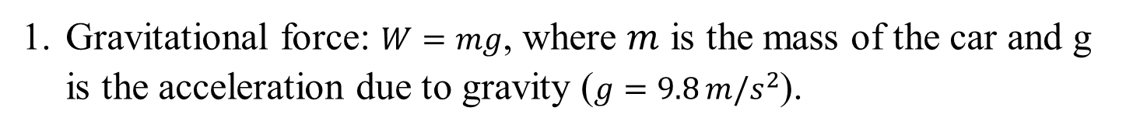
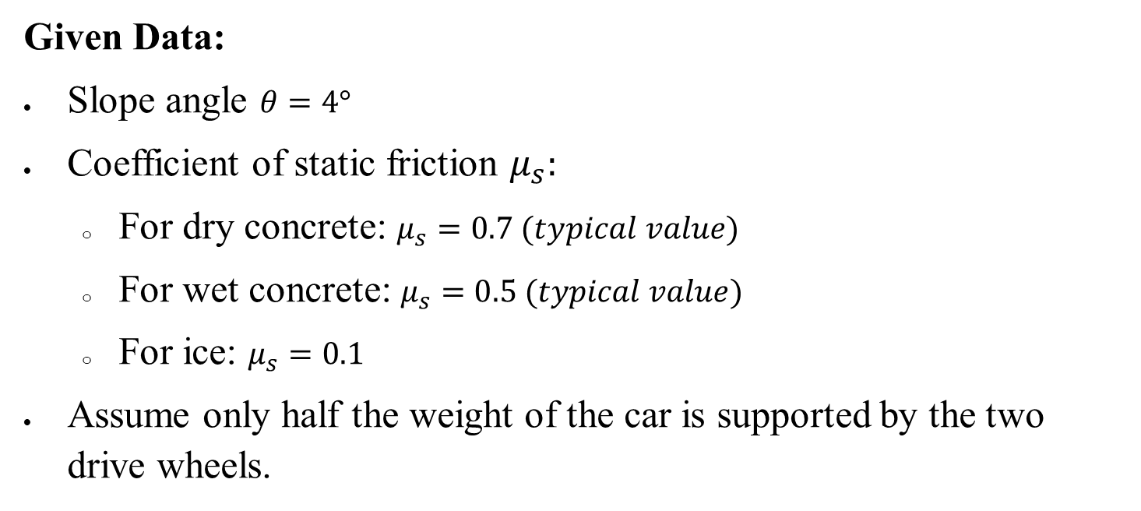
Question 4: ANSWERS
Given Data:
Slope angle $θ=4°$
Coefficient of static friction $μ_{s}:$
For dry concrete: $μ_{s}=0.7 (typical value)$
For wet concrete: $μ_{s}=0.5 (typical value)$
For ice: $μ_{s}=0.1$
Assume only half the weight of the car is supported by the two drive wheels.
Forces Acting on the Car
Gravitational force: $W=mg$, where $m$ is the mass of the car and g is the acceleration due to gravity ($g=9.8 m/s^{2}$).

Slide 22
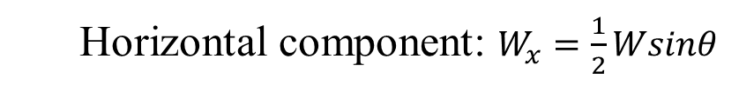
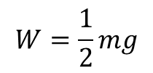
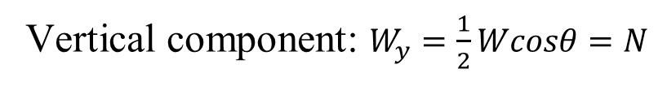

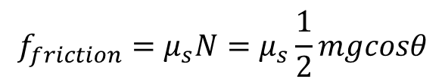
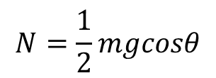
Question 4: ANSWERS
Forces Acting on the Car
Component of the Gravitational force acting on the two wheels:
Vertical component: $W_{y}=\frac{1}{2}Wcosθ=N$
$$W=\frac{1}{2}mg$$
Horizontal component: $W_{x}=\frac{1}{2}Wsinθ$
Normal force on the drive wheels: Since half the weight is supported by the drive wheels:
$$N=\frac{1}{2}mgcosθ$$
Frictional force: The frictional force that prevents slipping is:
$$f_{friction}=μ_{s}N=μ_{s}\frac{1}{2}mgcosθ$$
Gravitational force component along the slope: The component of the gravitational force acting down the slope is:
$$W_{x}=mgsinθ$$

Slide 23
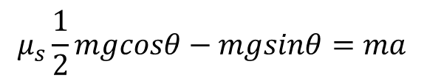

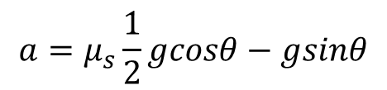
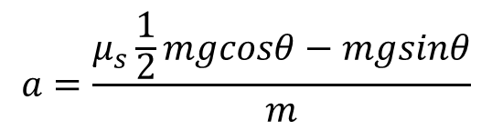
Question 4: ANSWERS
Applying Newton's Second Law
For maximum acceleration, the net force along the slope should equal the mass times acceleration:
$$f_{friction}−W_{x}=ma$$
Substituting the forces:
$$μ_{s}\frac{1}{2}mgcosθ−mgsinθ=ma$$
Simplifying for a:
$$a=\frac{μ_{s}\frac{1}{2}mgcosθ−mgsinθ}{m}$$
$$a=μ_{s}\frac{1}{2}gcosθ−gsinθ$$

Slide 24
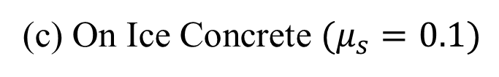
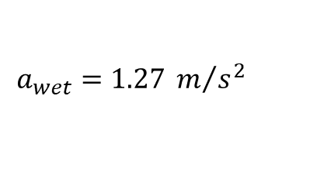
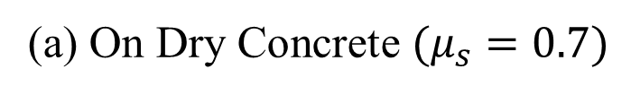
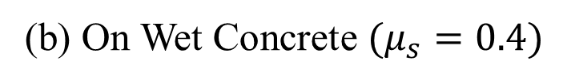
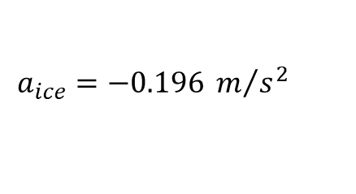
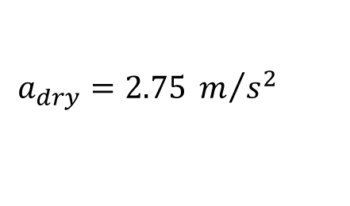
Question 4: ANSWERS
Calculate Acceleration for Each Condition
(a) On Dry Concrete $(μ_{s}=0.7)$
$$a_{dry}=\frac{1}{2}\left(0.7\right)\left(9.81 m/{s^{2}}\right)cos\left(4°\right)−\left(9.81 m/{s^{2}}\right)sin\left(4°\right)$$
$$a_{dry}=2.75 m/{s^{2}}$$
(b) On Wet Concrete $(μ_{s}=0.4)$
$$a_{wet}=\frac{1}{2}\left(0.4\right)\left(9.81 m/{s^{2}}\right)cos\left(4°\right)−\left(9.81 m/{s^{2}}\right)sin\left(4°\right)$$
$$a_{wet}=1.27 m/{s^{2}}$$
(c) On Ice Concrete $(μ_{s}=0.1)$
$$a_{ice}=\frac{1}{2}\left(0.1\right)\left(9.81 m/{s^{2}}\right)cos\left(4°\right)−\left(9.81 m/{s^{2}}\right)sin\left(4°\right)$$
$$a_{ice}=−0.196 m/{s^{2}}$$
This negative value indicates that the car would not be able to accelerate up the slope on ice, but rather would slide backward.

Slide 25
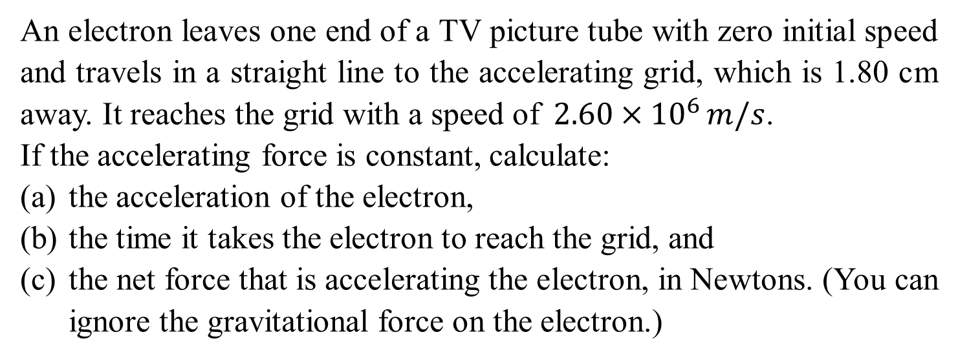
Question 5
An electron leaves one end of a TV picture tube with zero initial speed and travels in a straight line to the accelerating grid, which is 1.80 cm away. It reaches the grid with a speed of$2.60×{10}^{6 }m/s$.
If the accelerating force is constant, calculate:
the acceleration of the electron,
the time it takes the electron to reach the grid, and
the net force that is accelerating the electron, in Newtons. (You can ignore the gravitational force on the electron.)

Slide 26

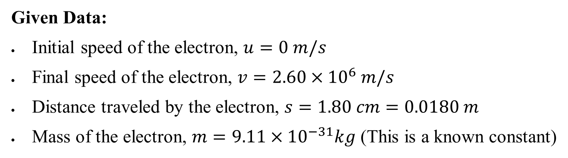


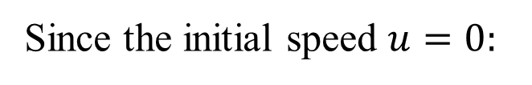
Question 5: ANSWERS
Given Data:
Initial speed of the electron, $u=0 m/s$
Final speed of the electron, $v=2.60×{10}^{6} m/s$
Distance traveled by the electron, $s=1.80 cm=0.0180 m$
Mass of the electron, $m=9.11×{10}^{−31}kg$ (This is a known constant)
(a) Acceleration of the Electron
We can use the following kinematic equation to find the acceleration a:
$$v^{2}=u^{2}+2as$$
Since the initial speed $u=0:$
$$v^{2}=2as$$
Solving for acceleration a:
$$a=\frac{v^{2}}{2s}$$

Slide 27
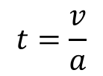








Question 5: ANSWERS
(a) Acceleration of the Electron
Solving for acceleration a:
$$a=\frac{v^{2}}{2s}$$
Substitute the given values:
$$a=\frac{{\left(2.60×{10}^{6} m/s\right)}^{2}}{2\left(0.0180 m\right)}$$
$$a=1.88×{10}^{14} m/{s^{2}}$$
(b) Time to Reach the Grid
We can use the following kinematic equation to find the time t:
$$v=u+at$$
Since the initial speed $u=0:$
$$v=at$$
Solving for t:
$$t=\frac{v}{a}$$
$$t=\frac{2.60×{10}^{6} m/s}{1.88×{10}^{14} m/{s^{2}}}$$
$$t=1.38×{10}^{−8} s$$

Slide 28



Question 5: ANSWERS
(c) Net Force Acting on the Electron
The net force F acting on the electron can be found using Newton's second law:
$$F=ma$$
Substitute the mass of the electron and the acceleration:
$$F=\left(9.11×{10}^{−31}kg \right)\left(1.88×{10}^{14} m/{s^{2}}\right)$$
$$F=1.71×{10}^{−16}N$$

Slide 29
Question 6
You push your physics book 1.50 m along a horizontal tabletop with a horizontal push of 2.40 N while the opposing force of friction is 0.60 N. How much work does each of the following forces do on the book? (a) your 2.40 N push,
(b) the friction force,
(c) the normal force from the table, and
(d) gravity?
(e) What is the net work done on the book?

Slide 30







Question 6: ANSWERS
Given:
Displacement $d=1.50 m$
Push force ${F​}_{push}=2.40 N$
Friction force ${F​}_{friction}=0.600 N$
The normal force$F_{normal}​$ acts vertically upward.
Gravity ${F​}_{gravity}​=mg$
(a) Work Done by Your $2.40 N$Push
The push force is horizontal and in the same direction as the displacement, so $θ=0°$
$$W_{push}=F_{push}∙d∙cosθ$$
$$W_{push}=\left(2.40 N\right)∙\left(1.50 m\right)∙cos\left(0°\right)$$
$$W_{push}=3.60 J$$
So, the work done by the push is $3.60 J$

Slide 31







Question 6: ANSWERS
(b) Work Done by the Friction Force
The friction force opposes the motion, so $θ=180°$
$$W_{friction}=F_{friction}∙d∙cosθ$$
$$W_{friction}=\left(0.6 N\right)∙\left(1.50 m\right)∙cos\left(180°\right)$$
$$W_{friction}=−0.9 J$$
So, the work done by the friction force is $−0.9 J$
(c) Work Done by the Normal Force from the Table
The normal force acts perpendicular to the displacement (upward), so $θ=90°$:
$$W_{normal}=F_{normal}∙d∙cosθ$$
$$W_{normal}=F_{normal}∙\left(1.50 m\right)∙cos\left(90°\right)$$
$$W_{normal}=0 J$$
So, the work done by the normal force is $0 J$

Slide 32








Question 6: ANSWERS
(d) Work Done by gravity
Gravity acts vertically downward, so the angle between the force and the displacement is $θ=90°$:
$$W_{gravity}=F_{gravity}∙d∙cosθ$$
$$W_{gravity}=F_{gravity}∙\left(1.50 m\right)∙cos\left(90°\right)$$
$$W_{gravity}=0 J$$
So, the work done by the gravity is $0 J$
(e) Net Work Done on the Book
The net work done on the book is the sum of the work done by
all the forces:
$$W_{net}=W_{push}+W_{friction}+W_{normal}+W_{gravity}$$
$$W_{net}=3.60 J+\left(−0.9 J\right)+0 J+0 J$$
$$W_{net}=2.70 J$$
So, the net work done on the book is $2.70 J$

Slide 33

Question 7
A bullet is fired into a large stationary absorber and comes to rest. Temperature measurements of the absorber show that the bullet lost 1960 J of kinetic energy, and high-speed photos of the bullet show that it was moving at$400 m/s$ as it struck the absorber. What is the mass of the bullet?

Slide 34








Question 7: ANSWERS
To find the mass of the bullet, we can use the relationship between the kinetic energy and the velocity of the bullet. The kinetic energy $(K)$of an object is given by:
$$K=\frac{1}{2}mv^{2}$$
Where:
$K$ is the kinetic energy $(1960 J)$
$m$ is the mass of the bullet (unknown)
$v$ is the velocity of the bullet just before it struck the absorber $(given as 400 m/s)$
We can rearrange this equation to solve for the mass $m$:
$$K=\frac{1}{2}mv^{2}→$$
$$m=\frac{2K}{v^{2}}→$$
$$m=\frac{2\left(1960 J\right)}{{\left(400 m/s\right)}^{2}}$$
$$m=0.0245 kg$$
So, the mass of the bullet is $0.0245 kg$

Slide 35


Question 8
A roller coaster train of mass $3.0×{10}^{3} kg$ travels at $8.34 m/s$and enters a railway station. Once in the station, brakes are applied to the train to slow it down to $1.00 m/s$in $5.44 m$.
(a) Calculate the braking force slowing the train?
(b) How much time did it take to slow the train down?
(c) What was the acceleration of the train in g’s?
Given:
Mass of the roller coaster train: $3.0 ×{10}^{3} kg$
Initial speed: $​v_{i}=8.34 m/s$
Final speed after braking: $​v_{f}=1.0 m/s$
Distance over which the brakes were applied: $​d=5.44 m$

Slide 36







Question 8: ANSWERS
(a) Braking Force
To find the braking force, we can use the work-energy principle. The work done by the braking force is equal to the change in kinetic energy of the train:
$$Work=∆K=\frac{1}{2}mv_{f}^{2}−\frac{1}{2}mv_{i}^{2}$$
The work done by the braking force $F$ over the distance $d$ is:
$$F×d=\frac{1}{2}mv_{f}^{2}−\frac{1}{2}mv_{i}^{2}$$
Equating the two expressions:
$$Work=F×d→$$
$$F=\frac{\frac{1}{2}mv_{f}^{2}−\frac{1}{2}mv_{i}^{2}}{d}$$
Solving for $F$:
$$F=\frac{\frac{1}{2}\left(3.0 X {10}^{3} kg\right){\left(1.0 m/s\right)}^{2}−\frac{1}{2}\left(3.0 X {10}^{3} kg\right){\left(8.34 m/s\right)}^{2}}{5.44 m}$$
Substitute the
given values:
$$F=\frac{−102833.4}{5.44}=−18903 N$$
So, the braking force is approximately $F=−18903 N$(negative sign indicates it's a decelerating force).

Slide 37











Question 8: ANSWERS
(b) Time Taken to Slow Down
We can use the kinematic equation to find the time:
$$v_{f}=v_{i}+at$$
Here, $a$ is the acceleration, which can be found using:
$$v_{f}^{2}=v_{i}^{2}+2as$$
$$a=\frac{v_{f}^{2}−v_{i}^{2}}{2s}$$
Solving for $a$:
Substituting the values:
$$a=\frac{{\left(1.0 m/s\right)}^{2}−{\left(8.34 m/s\right)}^{2}}{2\left(5.44\right)}$$
$$a=\frac{−68.55}{10.88}$$
$$a=−6.30 m/{s^{2}}$$
Now, using $v_{f}=v_{i}+at$
$$1 =8.34+\left(−6.30\right)t$$
$$t=\frac{1−8.34}{−6.30}$$
$$t=1.16 s$$
So, it took approximately $t=1.16 s$ to slow down.

Slide 38





Question 8: ANSWERS
(c) Acceleration in g's
The acceleration $a$ found in part (b) is $6.30 m/s^{2}$. To express this in terms of $g$ $(where g≈9.81\frac{m}{s^{2}})$:
$$Acceleration g^{′}s=\frac{a}{g}$$
$$Acceleration g^{′}s=\frac{−6.30 }{9.81}=−0.64 g$$
A$cceleration g^{′}s=−0.64 g$
So, the deceleration is approximately $=0.64 g$.

Slide 39
Q&A? Office hours:

Slide 40

Question 9-Extension
What is the acceleration of two falling sky divers (mass = 123 kg including parachute) when the upward force of air resistance is equal to one-fourth of their weight?
After popping open the parachute, the divers descend leisurely to the ground at constant speed. What now is the force of air resistance on the sky divers and their parachute?

Slide 41









Question 9: ANSWERS
(a) Acceleration of two falling sky divers
There will be two forces on the skydivers – their combined weight, and the upward force of air resistance $F_{A}$. Choosing upwards to be the positive direction. Write Newton’s second law for the skydivers.
$$\sum{F}=F_{A}−mg=ma$$
$$\sum{F}=\frac{1}{4}mg−mg=ma$$
$$\left(\frac{1}{4}g−g\right)m=ma$$
$$\left(\frac{1}{4}g−g\right)=a$$
$$\left(\frac{1}{4}−1\right)g=a$$
$$\left(−0.75\right)9.81 m/s^{2}=a$$
$$a=−7.35 m/s^{2}$$
Due to the sign of the result, the direction of the acceleration is down.

Slide 42





Question 9: ANSWERS
(b) the force of air resistance on the sky divers and their parachute
If they are descending at constant speed, then the net force on them must be zero, and so the force of air resistance must be equal to their weight.
$$\sum{F}=F_{A}−mg=0$$
$$F_{A}−mg=0$$
$$F_{A}=mg$$
$$F_{A}=\left(123 kg\right)\left(9.81 m/s^{2}\right)$$
$$F_{A}=1294 N$$

Slide 43

Question 10-Extension
If m_{A} = 13.0 kg and m_{B} = 5.0 kg, are shown in the figure below, determine the acceleration of each block.
If initially m_{A} is at rest 1.25 m from the edge of the table, how long does it take to reach the edge of the table if the system is allowed to move freely?
If m_{B} = 1.0 kg, how large must m_{A} be if the acceleration of the system is to be kept at 0.01 g?

Slide 44








Question 10: ANSWERS
(a) determine the acceleration of each block
Both blocks have the same acceleration.
$$a∙\left(m_{A}+ m_{B}\right)=m_{B}∙g$$
$a$ = $\left(\frac{m_{B}}{m_{A}+ m_{B}}\right)g$
$$a=\left(\frac{5.0 kg}{5.0 kg + 13 kg}\right)\text{9.81 }\text{m}\text{/}\text{s}\text{2}$$
$a$ = 2.722 m/s²
(b) how long does it take to reach the edge of the table
$$t=\sqrt{\frac{2\left(x \text{− }x_{0}\right)}{a}}$$
$$t=\sqrt{\frac{2\left(1.25 m\right)}{2.722 \text{m}\text{/}\text{s}\text{2}}}$$
$x{−x}_{0}$= $v_{0}t$ + $\frac{1}{2} {at }^{2}$
$t=$ 0.96 s

Slide 45




Question 10: ANSWERS
(c) acceleration of the system is to be kept at 0.01 g
Again use the acceleration expression from part (a)
$$a=\left(\frac{m_{B}}{m_{A}+ m_{B}}\right)g= \text{0.01 }\text{g}$$
$$\left(\frac{m_{B}}{m_{A}+ m_{B}}\right)=0.01$$
$$m_{A}=\text{99 }m_{B}$$
$${Therefore, m}_{A}=99kg$$

Slide 46

Question 11-Extension
Two masses m_{A} = 2.0 kg and m_{B} = 5.0 kg are on inclines and are connected together by a string. The coefficient of kinetic friction (µ_{k}) between each mass and its incline, µ_{k} = 0.30. If m_{A} moves up, and m_{B} moves down, determine their acceleration.

Slide 47

Question 11: ANSWERS
Free-Body Diagram

Slide 48






Question 11: ANSWERS
Block A:
$\sum{F= F_{yA}}$ = $F_{NA }$- $m_{A}$.g.cosθ_{A} = 0
$F_{NA }=$ $m_{A}$.g.cosθ_{A}
$\sum{F= F_{xA}}$ = $F_{T }$- $m_{A}$.g.sinθ_{A} - $F_{frA }$ = $m_{A}$. $a$
Block B:
$\sum{F= F_{yB}}$ = $F_{NB }$- $m_{B}$.g.cosθ_{B} = 0
$F_{NB }=$ $m_{B}$.g.cosθ_{B}
$\sum{F= F_{xB}}$ = $m_{B}$.g.sinθ_{B} - $F_{frB }$ ${−F}_{T }$= $m_{B}$. $a$

Slide 49






Question 11: ANSWERS
Add the final equations together from both analyses and solve for the acceleration, noting that in both cases the friction force is found as $F_{fr}= μF_{N}.$
$m_{A}$.$a=F_{T }\text{− }m_{A}\text{.}\text{g}\text{.}\text{sin}\text{θ}\text{A}$ - µ_{A}.$m_{A}$.g.cosθ_{A}
$m_{B}$.$a=m_{B}\text{.}\text{g}\text{.}\text{sin}\text{θ}\text{B}$ - µ_{B}.$m_{B}$.g.cosθ_{B} - $F_{T }$
$m_{A}$.$a+m_{B}\text{.}a$ = $F_{T }\text{− }m_{A}\text{.}\text{g}\text{.}\text{sin}\text{θ}\text{A}$ - µ_{A}.$m_{A}$.g.cosθ_{A} + $m_{B}\text{.}\text{g}\text{.}\text{sin}\text{θ}\text{B}$ - µ_{B}.$m_{B}$.g.cosθ_{B} - $F_{T }$
$$a=g\left[\frac{−m_{A}\left(\text{sin}{\text{θ}}_{A}\text{ +} \text{µ}\text{A}\text{.} \text{cos}\text{θ}\text{A}\right)+m_{B}\left(\text{sin}{\text{θ}}_{B} \text{− }\text{µ}\text{B}\text{.} \text{cos}\text{θ}\text{B}\right) }{m_{A}+m_{B}}\right]$$
$$a=9.8 m/s^{2}\left[\frac{−2kg\left(\text{sin}\text{51}°\text{ +} \text{0.3}\text{.} \text{cos}\text{51}°\right)+5kg\left(\text{sin}\text{21}°\text{−}\text{0.3}\text{.} \text{cos}\text{21}°\right) }{m_{A}+m_{B}}\right]$$
$a\text{= }\text{−}\text{2.2 }\text{m}\text{/}s^{2}$

